Slide 1

.
GOODBYE STUFF
[Garbage collector]
PRIYA SAINI – 20BCS7033
SHIVANI KUMARI – 20BCS7057
SMRITI SUMAN – 20BCS7058

Slide 2

INTRODUCTION
Goodbye Stuff (or waste disposal) includes the processes and actions required to manage waste from its inception to its final disposal. This includes the collection, transport, treatment and disposal of waste, together with monitoring and regulation of the waste management process and waste-related laws, technologies, economic mechanisms.

Slide 3

AIM
The aim of Goodbye stuff is to reduce the dangerous effects of such waste on the environment and human health. A big part of goodbye stuff deals with municipal solid waste, which is created by industrial, commercial, and household activity.

Slide 4

ABOUT :
Waste can be solid, liquid, or gaseous and each type has different methods of disposal and management. Waste management deals with all types of waste, including industrial, biological, household, municipal, organic, biomedical, radioactive wastes. In some cases, waste can pose a threat to human health. Health issues are associated throughout the entire process of waste management. Health issues can also arise indirectly or directly. Directly, through the handling of solid waste, and indirectly through the consumption of water, soil and food. Waste is produced by human activity, for example, the extraction and processing of raw materials. Waste management is intended to reduce adverse effects of waste on human health, the environment, planetary resources and aesthetics.

Slide 5
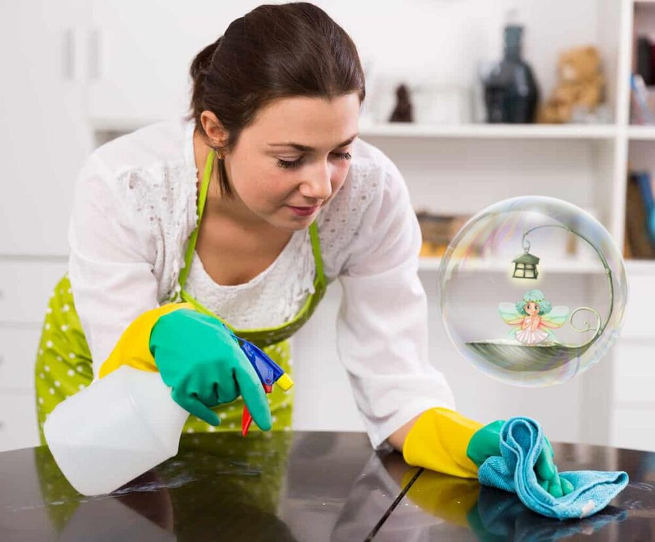
Principles of waste management:
Waste hierarchy
Life-cycle of a product
Resource efficiency
Polluter-pays principle

Slide 6


Waste is produced by human activity, for example, the extraction and processing of raw materials. Waste management is intended to reduce adverse effects of waste on human health, the environment or aesthetics. Here are some AVANGTAGES OF OUR PROJECT .
Advantages:
To keep the society clean .
Citizens will be provided efficient collection and disposal services of dry waste as well as wet waste .
To protects the environment through effectively controlling the pollutants .
The application of this project can be hostel premises where this system can be employed and the garbage from each room is collected in the bins and then this garbage can be disposed in a larger bin, where the garbage of the whole hostel is collected.
:

Slide 7
Scope
Create Efficiency and Convenience within Systems-usage
Change the Culture of Waste Handling through Mass-scale Education Programs
Develop & Implement Creative New Solutions using Research and Development
Utilize the Most Advanced Technology for Every day Systems & Operation

Slide 8
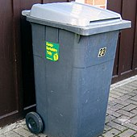
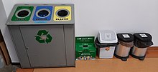
PLANNING :
Basically this project is a website where the user will be able to send the location of his/her locality so that out site members can go and collect the garbage in that particular area. Garbage and recycling pickup work is physically demanding and it exposes workers to a number of occupational hazards.
This project as named implies is designed to fulfill the task of collecting garbage from certain places and then dispose it at a single place from where the garbage could then be taken for disposal or process of recycling
Planning of our project
The project design is a part of the implication that can be used to improve the waste management of a locality. All the technical aspects have been thoroughly designed keeping all the constraints in mind.
The project resolves around whether the project will be able to meet the future needs of the users.
.

Slide 9
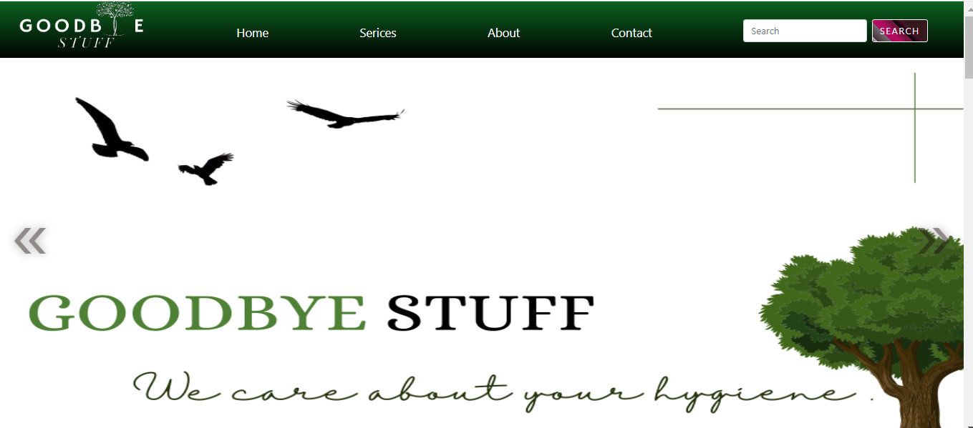
This is how our site looks .

Slide 10

Thank you!
goodbyestuff@garbagecollector.com
http://www.goodbyestuff.com/

